Slide 1
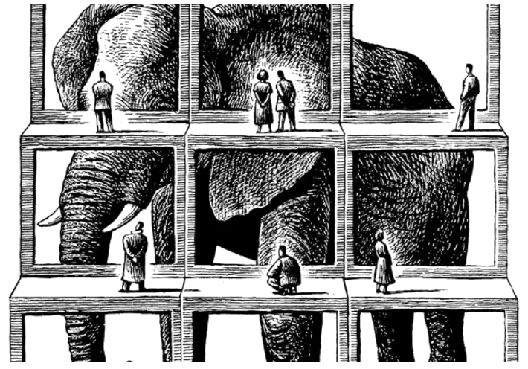




Context Matters Recovering Human Semantic Structure from Machine Learning Analysis of Large-Scale Text Corpora
Society for Neuroscience – 21 October 2019
Tyler Giallanza
Marius Cătălin Iordan
Cameron T. Ellis
Nicole Beckage
Jonathan D. Cohen

Slide 2
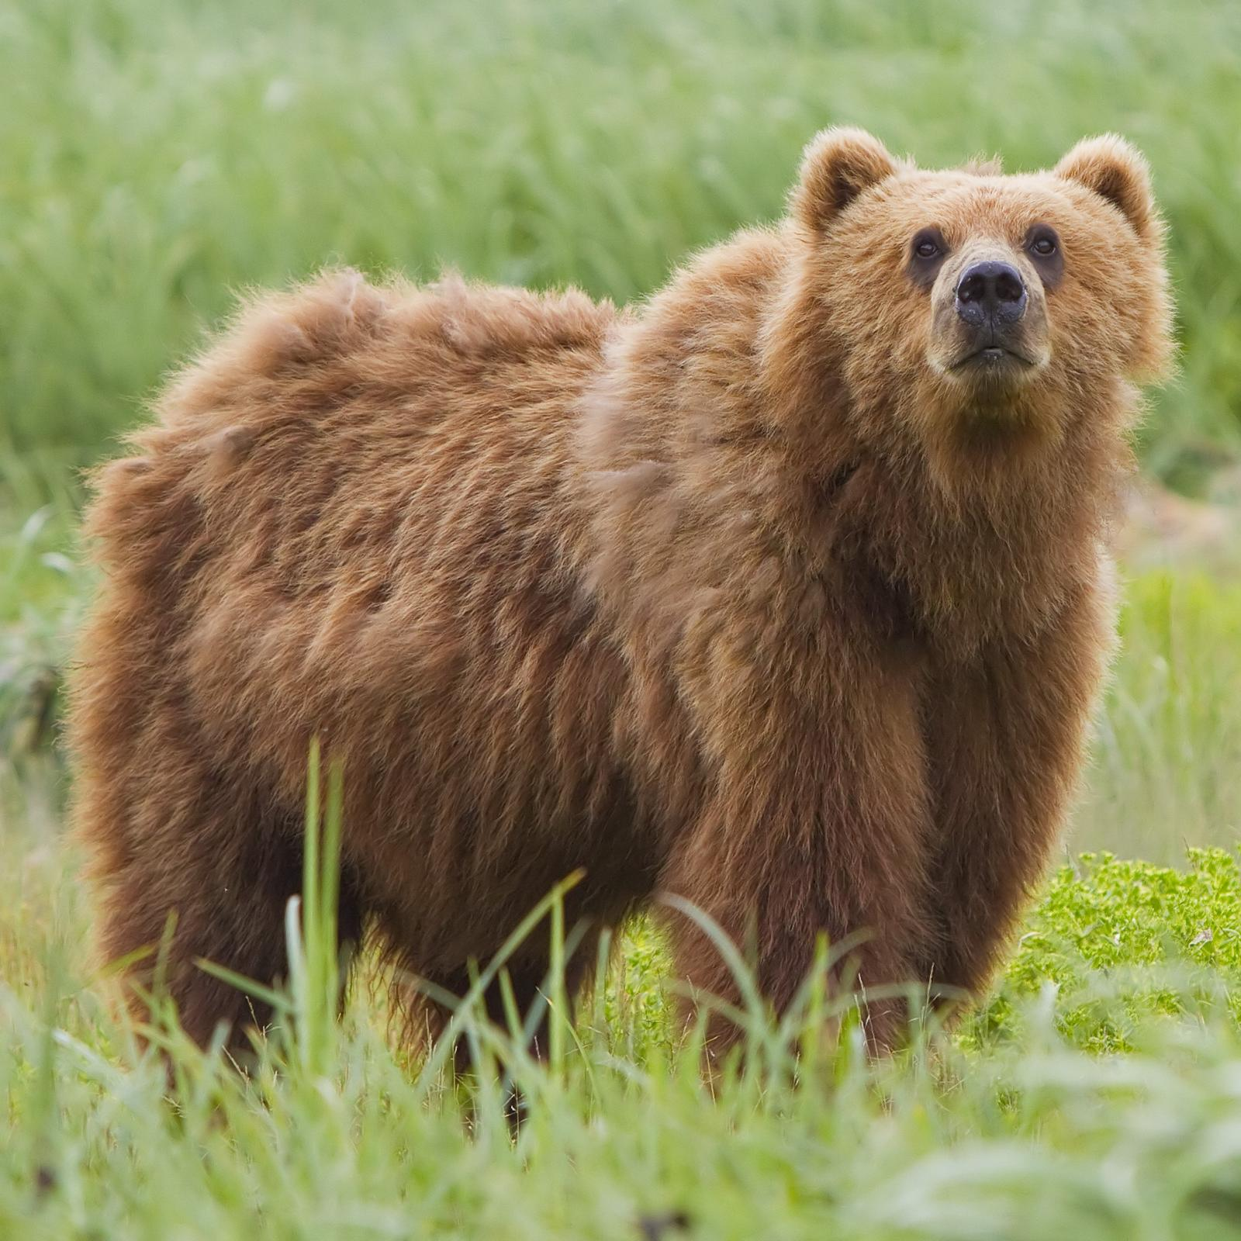
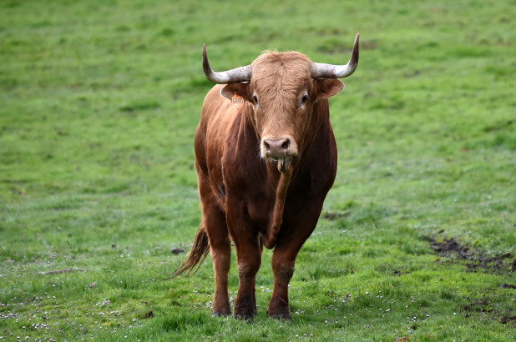
Semantic Similarity
How similar are these two animals on a scale of 1-5?
Nosofsky 1991, Tversky 1997, Osherson et al 1991

Slide 3
Collecting Similarity Judgments
Quadratic relationship between objects and comparisons
Lab Scale
Objects Comparisons
10 45
25 300
Human Scale
Objects Comparisons
30K 500K
Trillions 10^23
Biederman 1987

Slide 4
Estimating Similarity
bull
danger
similarity
bear
furriness
size
Size: 5
Danger: 4
Furriness: 5
Size: 4
Danger: 5
Furriness: 4
r=0.6-0.7
Nosofsky 1991, Tversky 1997, Osherson 1991, Iordan et al 2018

Slide 5
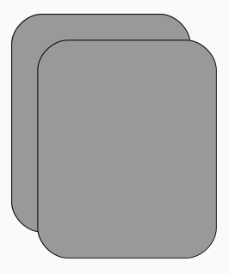
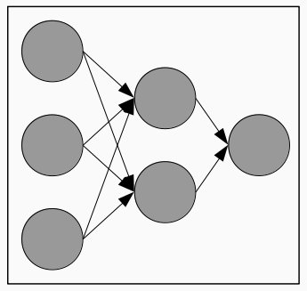
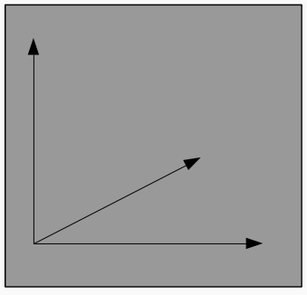
Estimating Similarity with Machine Learning
Text Documents
Estimated Semantic Space
Neural Network
Mikolov et al 2013, Pennington et al 2014, Pereira et al 2016

Slide 6
Estimating Similarity with Machine Learning
Psychology Approach
Low dimensional
Human-relevant dimensions
ML/NLP Approach
High dimensional
(Uninterpretable dimensions)
bear
bear
danger
bull
dimension 1
furriness
dimension 2
bull
size
dimension 3
r=0.6-0.7
r=0.1-0.6

Slide 7
Estimating Similarity with Machine Learning
Syntactic Context: Words that occur in similar contexts tend to have similar meanings
Similar Syntactic Context
“She saw the bear, which was no larger than the bull.”
“The economy finally recovered from the bear market, entering a bull market by 2012.”
Semantic Context 1
Semantic Context 2

Slide 8
Hypothesis
Semantic Context is a key factor in human semantic judgments
Accounting for semantic context will improve models of semantic judgments

Slide 9
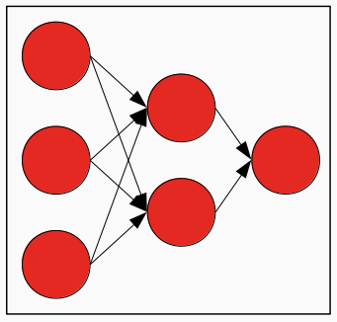
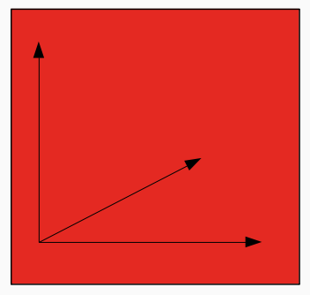

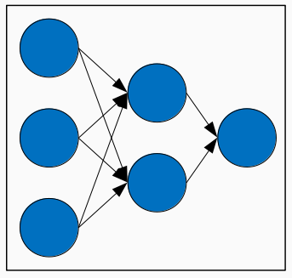
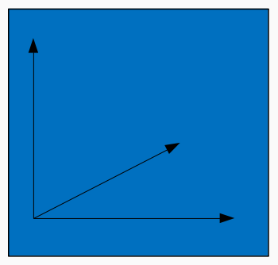
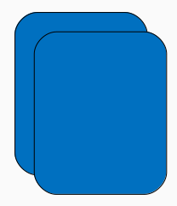
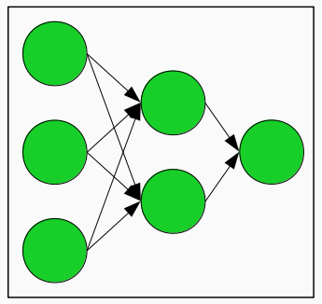
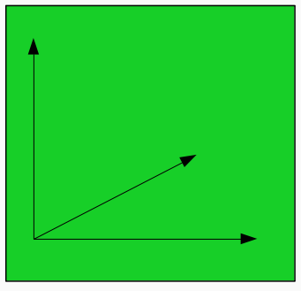
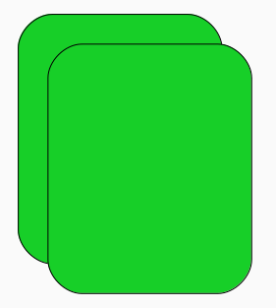
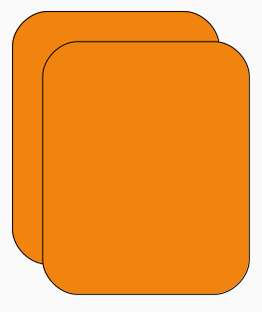
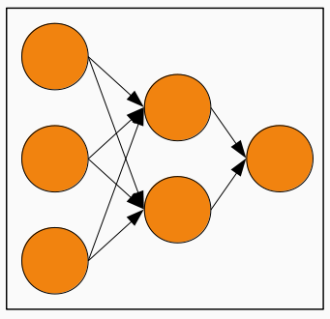
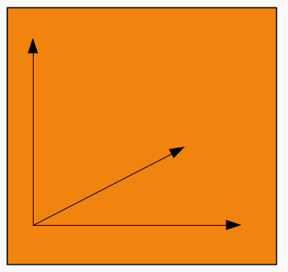
Building Context-Constrained Embedding Spaces
Wikipedia “Nature”
70M words
“Nature” Space
Wikipedia “Transport”
50M words
“Transport” Space
Wikipedia All Articles
2B words
Unconstrained Space
Common Crawl
60B words
Unconstrained Space

Slide 10
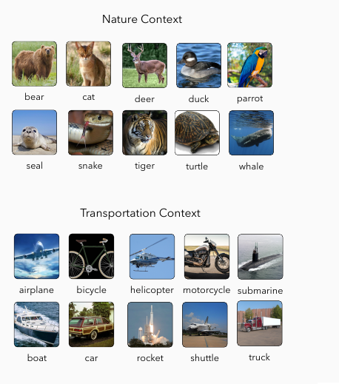
Experimental Design
Amazon Mechanical Turk
N=35

Slide 11
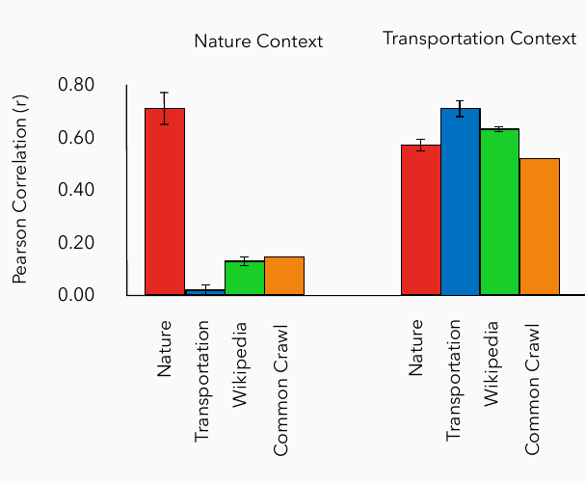
Context Constraints Improve Similarity Prediction

Slide 12
Contextual Dimensionality Reduction
300 dimensions
12 dimensions
Human relevant
Context relevant
bear
bear
danger
dimension 1
bull
furriness
dimension 2
bull
dimension 3
size

Slide 13
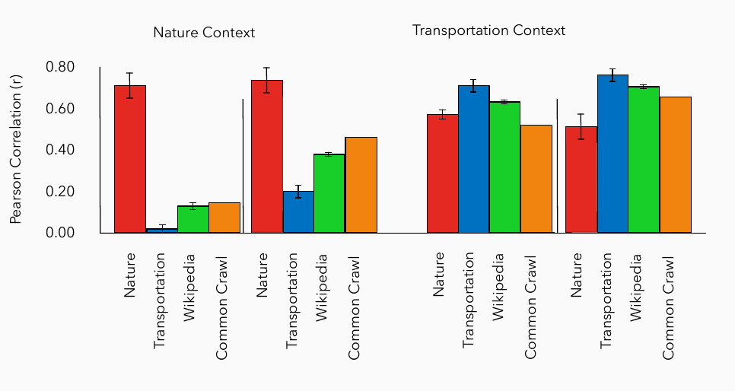
Contextual Dim. Reduction Predicts Similarity

Slide 14
Conclusion
Accounting for semantic context improves prediction of similarity
Improved embedding spaces with less training data
Potential for large-scale experiments using ML approach

Slide 15





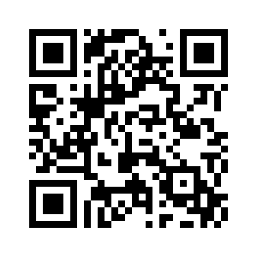
Tyler Giallanza
Marius Cătălin Iordan
Cameron
Ellis
Nicole
Beckage
Jonathan
Cohen
Context Matters: Recovering Human Semantic Structure from Machine Learning Analysis of Large-Scale Text Corpora
Iordan, Giallanza, Ellis, Beckage, and Cohen (arXiv 2019)
Neural Basis of Semantic Similarity: 361.07
mci@princeton.edu
tylergiallanza@gmail.com
Funding: Intel Corporation | John Templeton Foundation | NSF REU 1757554

Slide 16
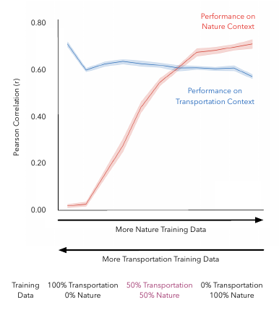
Titration

Slide 17
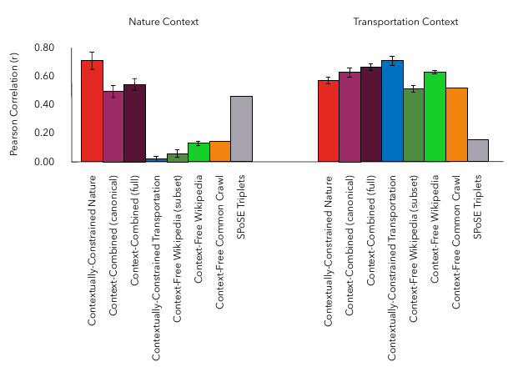
Titration Bars

Slide 18
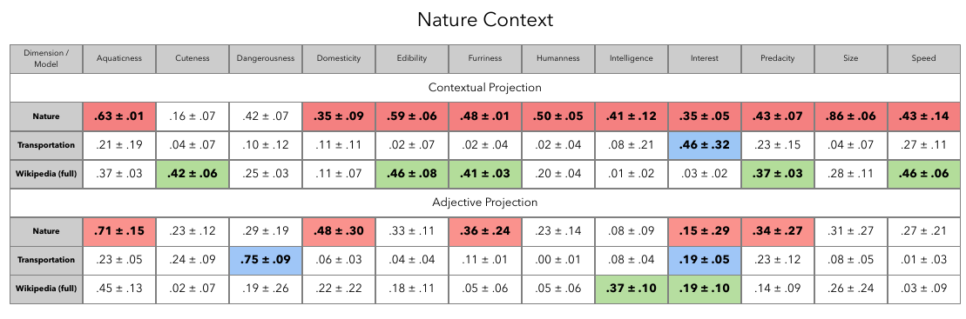
Nature Ft. Rating Table

Slide 19
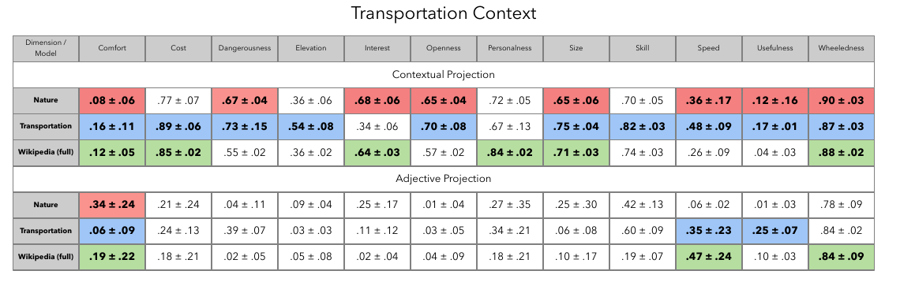
Transport Ft. Rating Table

Slide 20
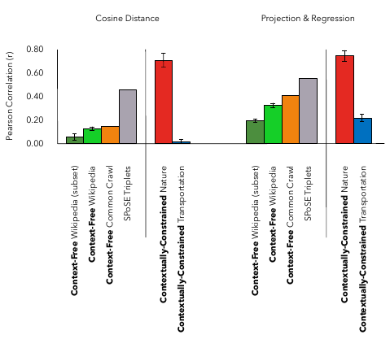
Nature Regression Graph

Slide 21
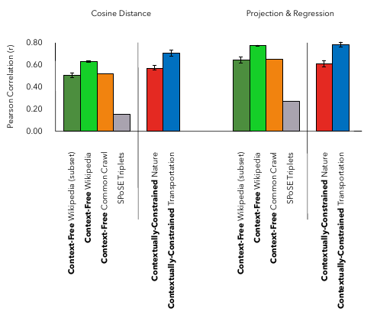
Transport Regression Graph

Slide 22
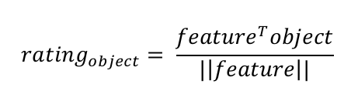
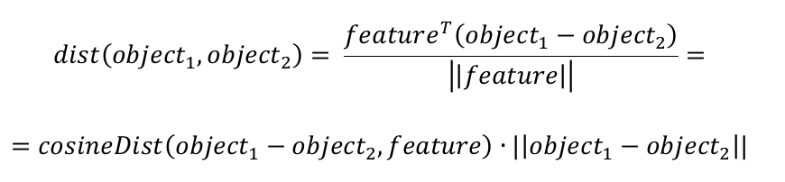
Projection Math

Slide 23
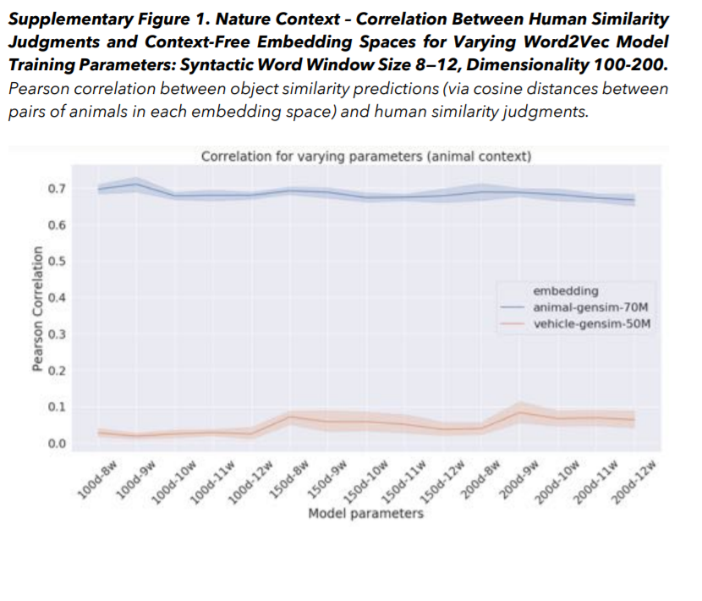
Parameters - Nature

Slide 24
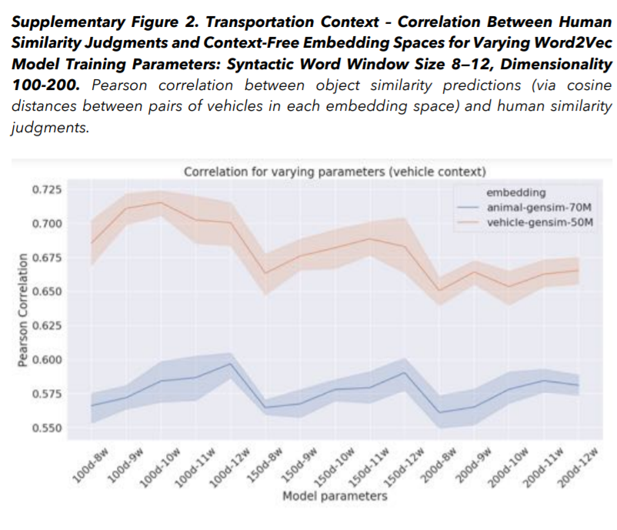
Parameters - Transport

Slide 25
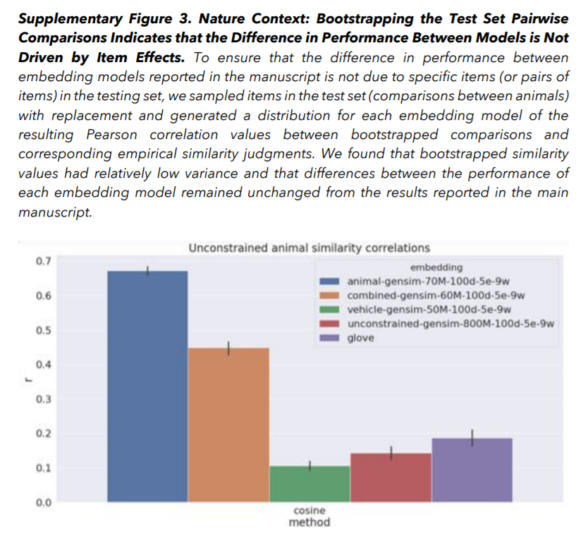
Bootstrap

Slide 26
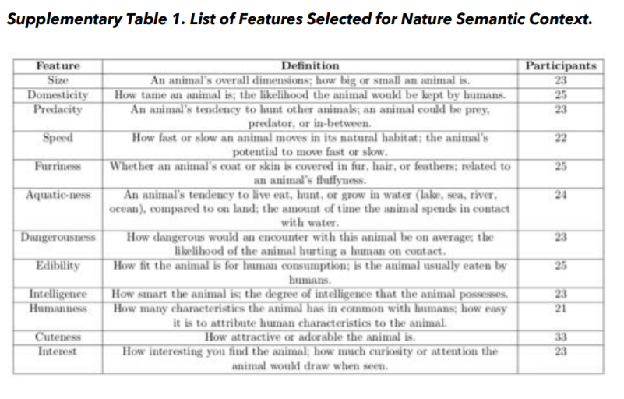
Features

Slide 27
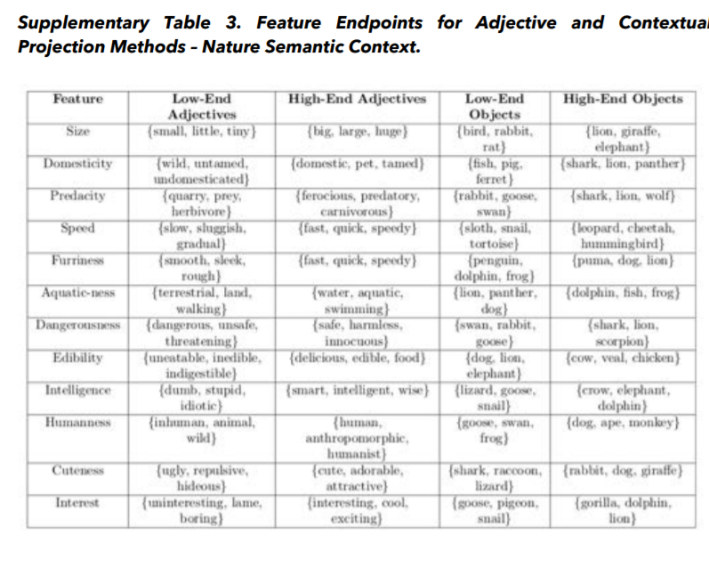
Endpoints

